Slide 1

SRI INDU
COLLEGE OF ENGINEERING AND TECHNOLOGY
UGC AUTONOMOUS INSTITUTION
DEPARTMENT OF COMPUTER SCIENCE AND ENGINEERING
BATCH: 2020-2024
MINI PROJECT
RECOGNITION OF DIGITAL HARASSMENT ON WEB-BASED SOCIAL CHANNELS
BATCH NO.-14
GUIDED BY:
:
TEAM MEMBERS:
Mrs.T.SAI SANTOSHI
~ ASST. PROF. DEPT. OF CSE
D.Tejaswini (20D41A0554)
B.Shiva Ganesh Sai Raj (20D41A0528)
C.Sripriya (20D41A0537)
A.Akshay (20D41A0506)

Slide 2



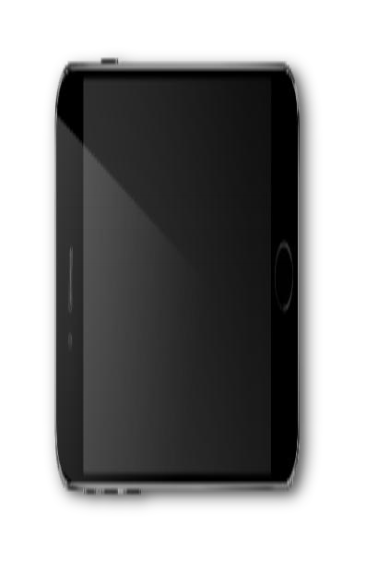
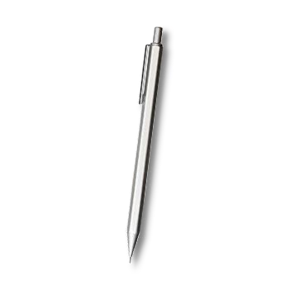

E
C
ABSTRACT
N
O
INTRODUCTION
SYSTEM ANALYSIS
T
N
SYSTEM REQUIREMENTS
SYSTEM ARCHITECTURE
S
T
UML DIAGRAMS
SCREENSHOTS OF EXECUTION
CONCLUSION

Slide 3
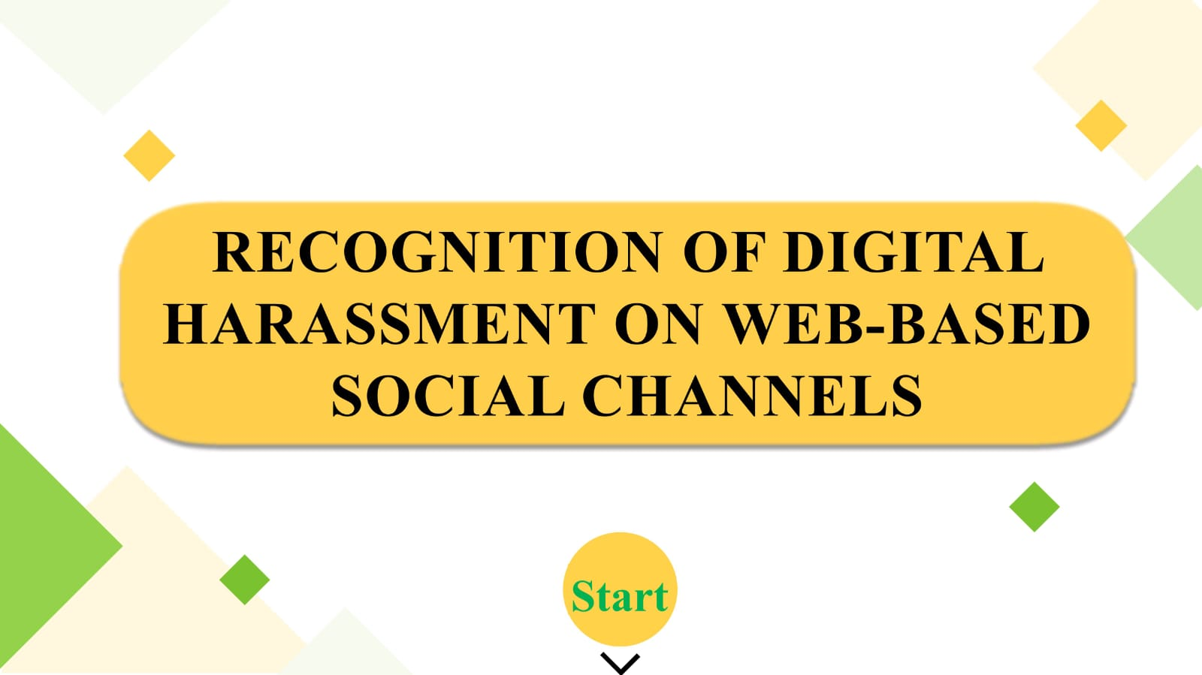

Slide 4
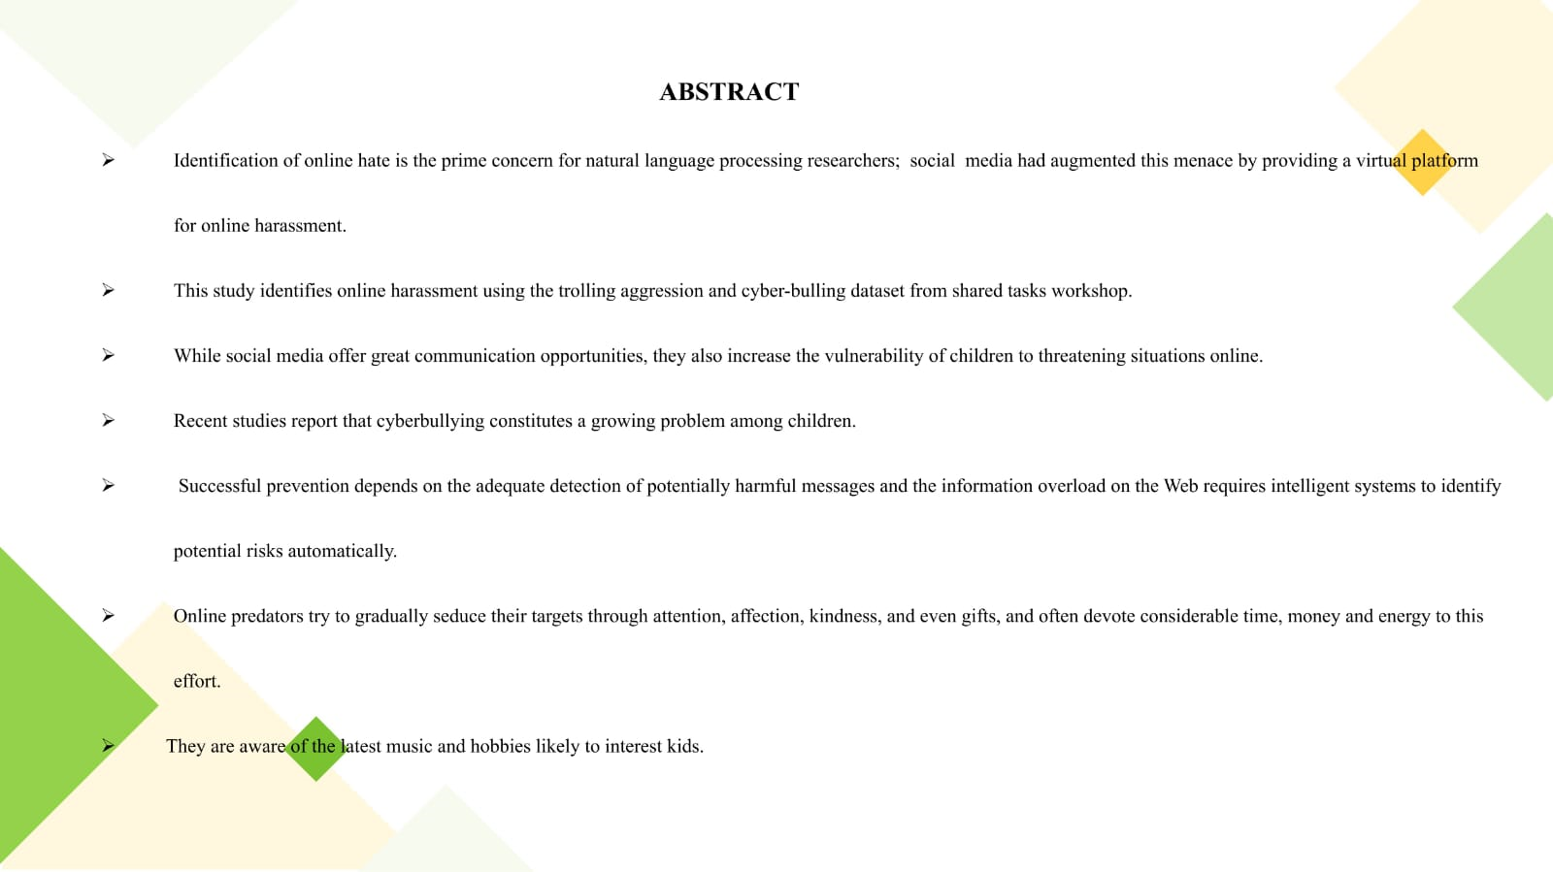

Slide 5
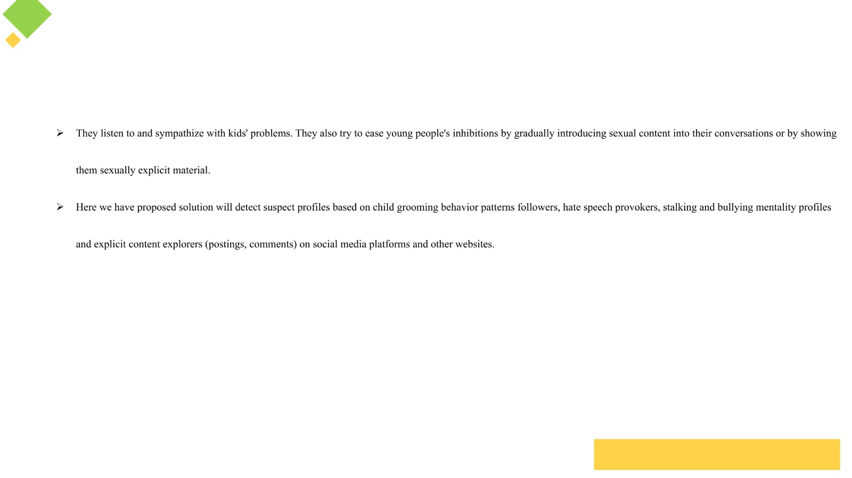

Slide 6
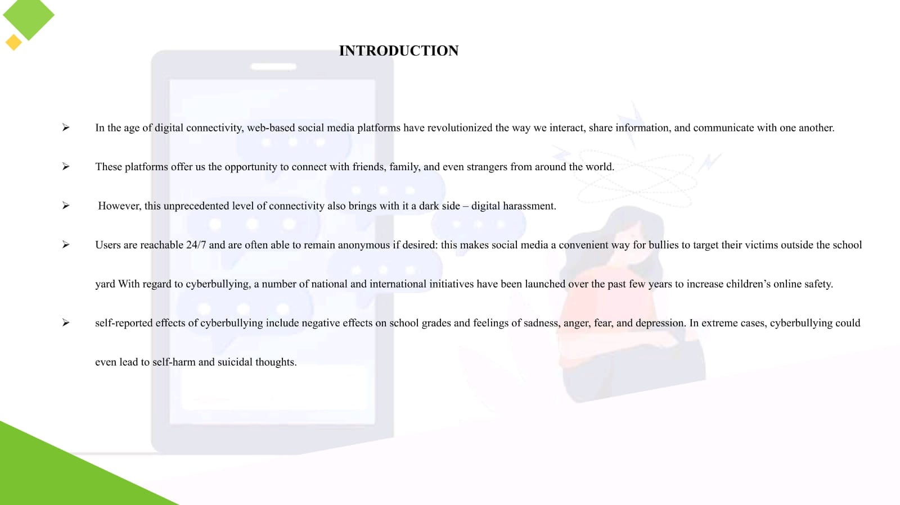

Slide 7
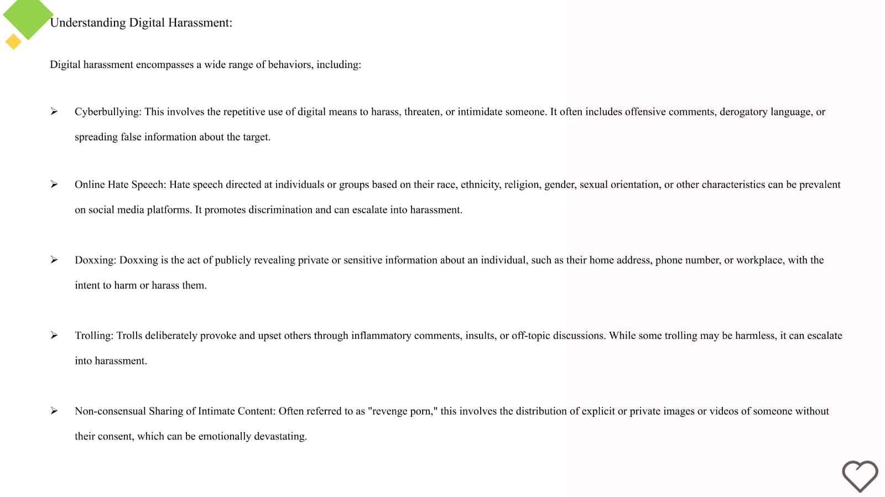

Slide 8
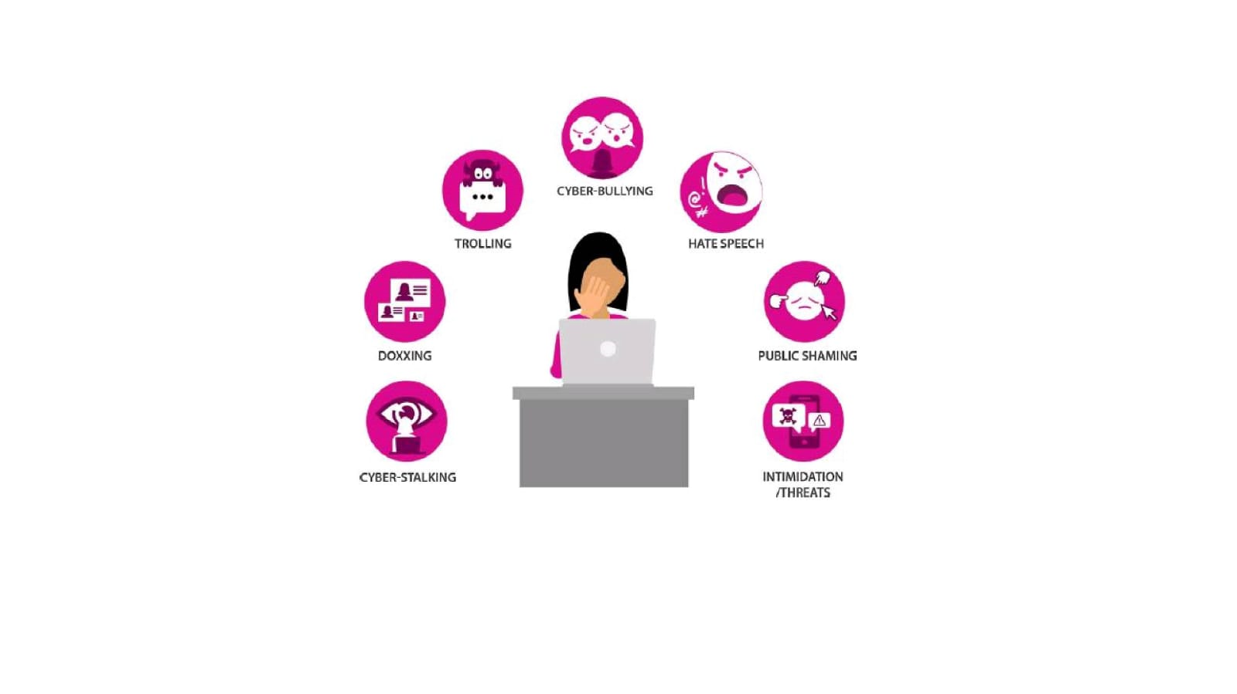

Slide 9
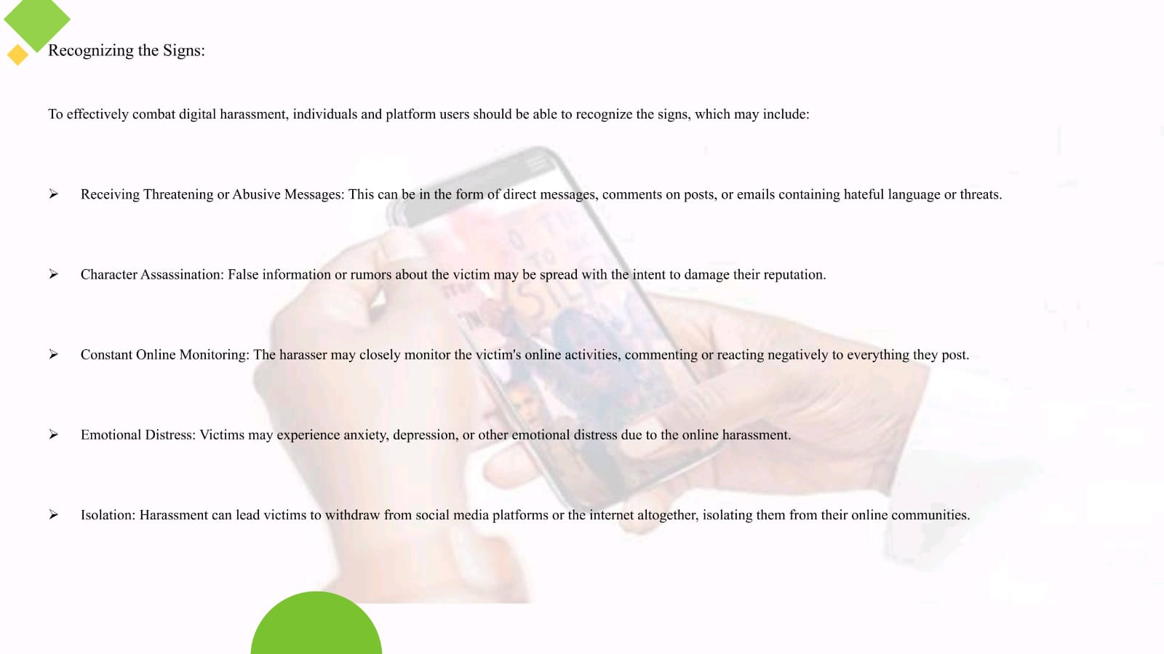

Slide 10
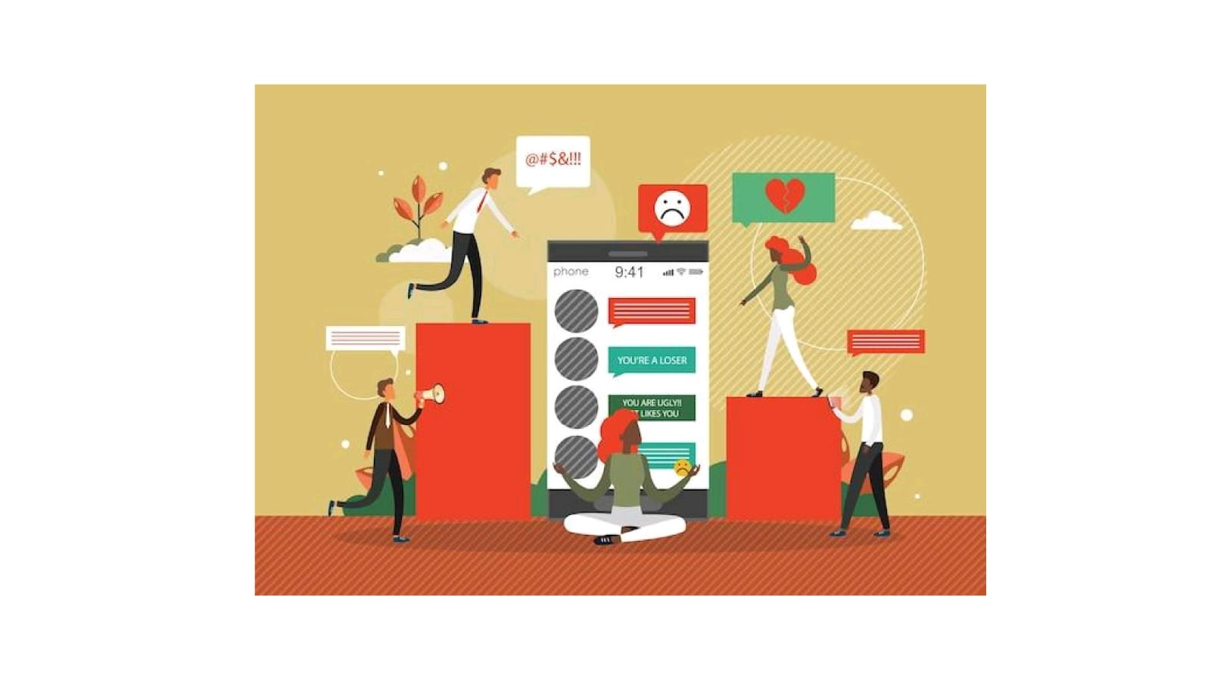

Slide 11
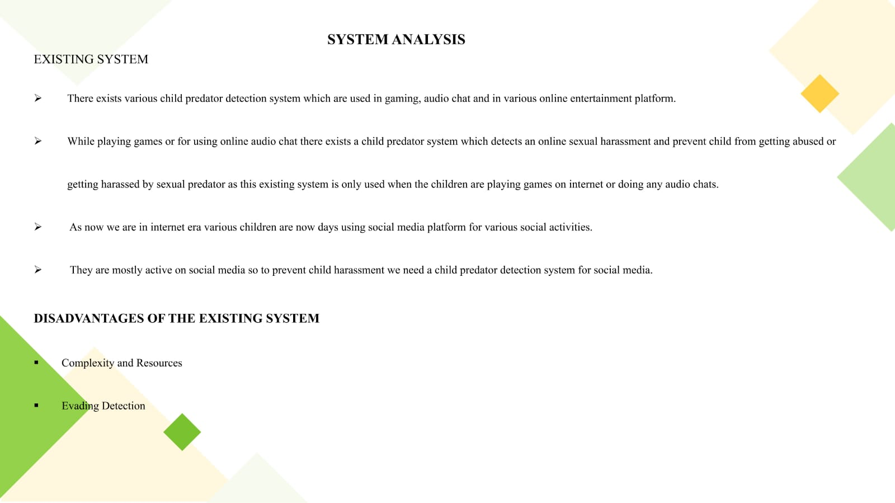

Slide 12
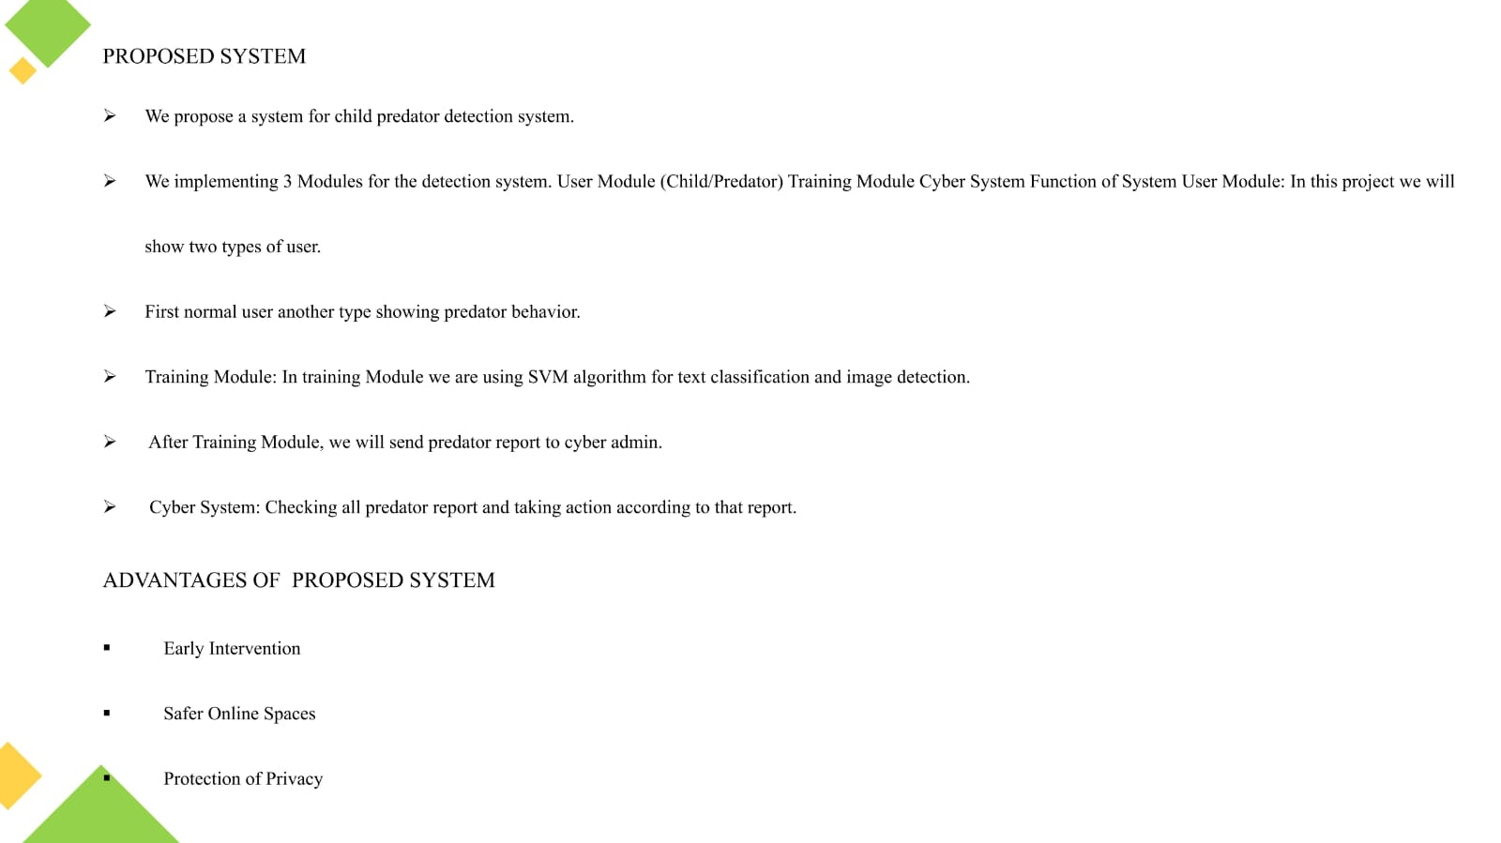

Slide 13
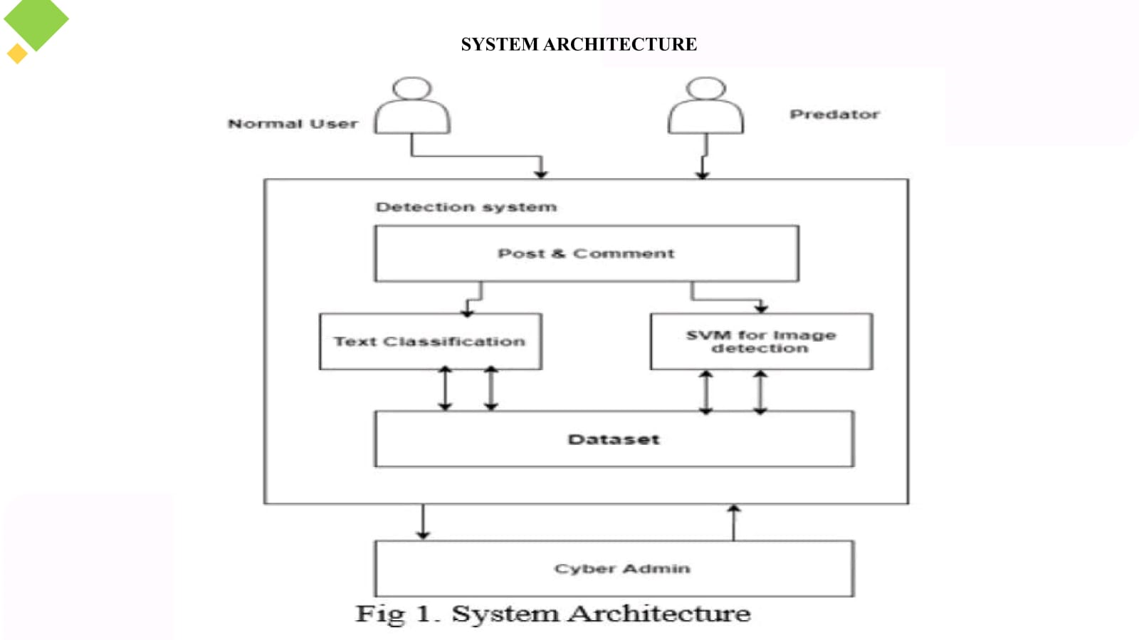

Slide 14
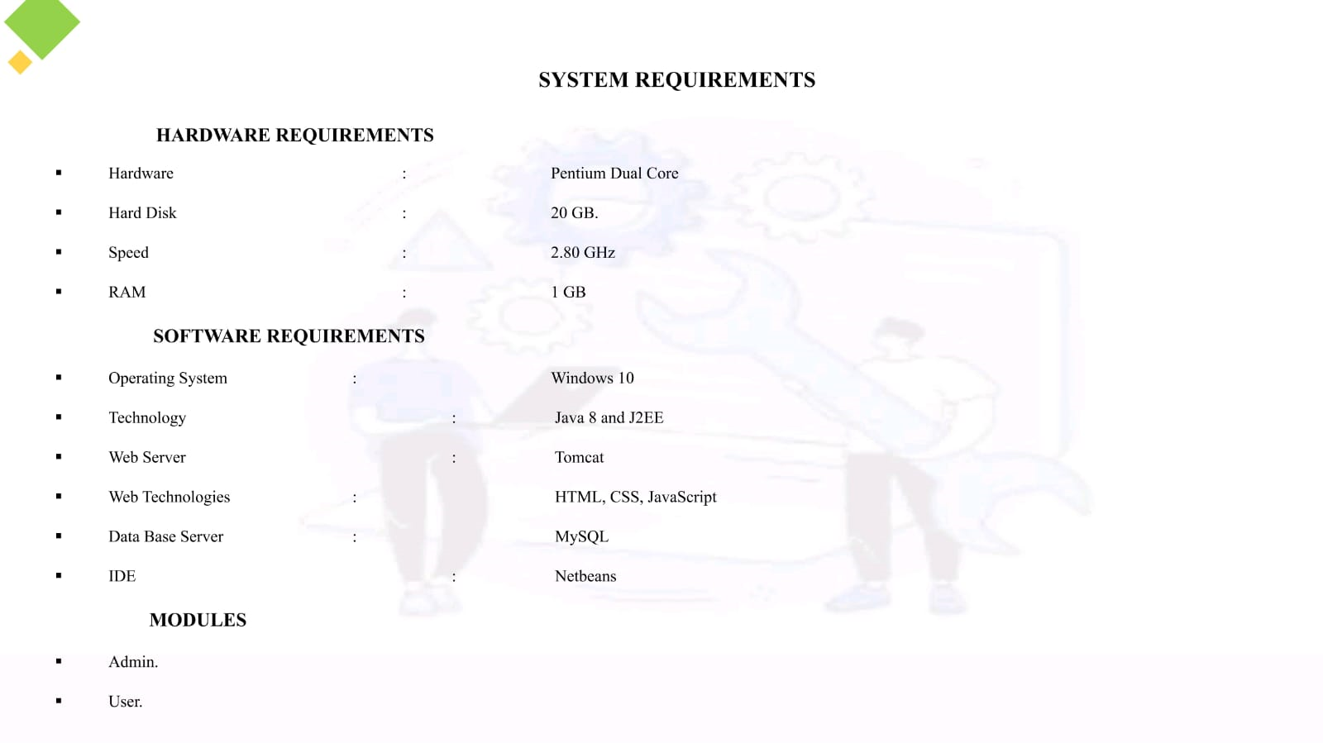

Slide 15
UML DIAGRAMS
UML stands for Unified Modeling Language. UML is a standardized general-purpose modeling language in the field of object-oriented software engineering. The standard is managed, and was created by, the Object Management Group.
The goal is for UML to become a common language for creating models of object oriented computer software. In its current form UML is comprised of two major components: a Meta- model and a notation. In the future, some form of method or process may also be added to; or associated with, UML.
The Unified Modeling Language is a standard language for specifying, Visualization, Constructing and documenting the artifacts of software system, as well as for business modeling and other non-software systems.
The UML represents a collection of best engineering practices that have proven successful in the modeling of large and complex systems.
The UML is a very important part of developing objects oriented software and the software development process. The UML uses mostly graphical notations to express the design of software projects.

Slide 16
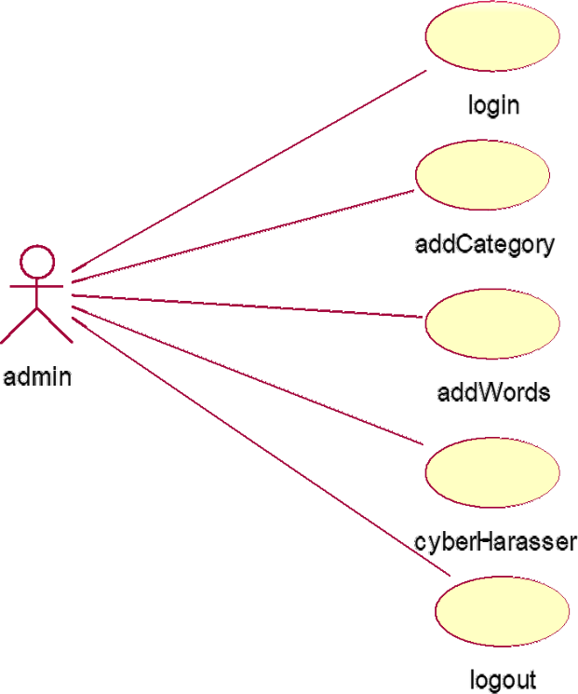
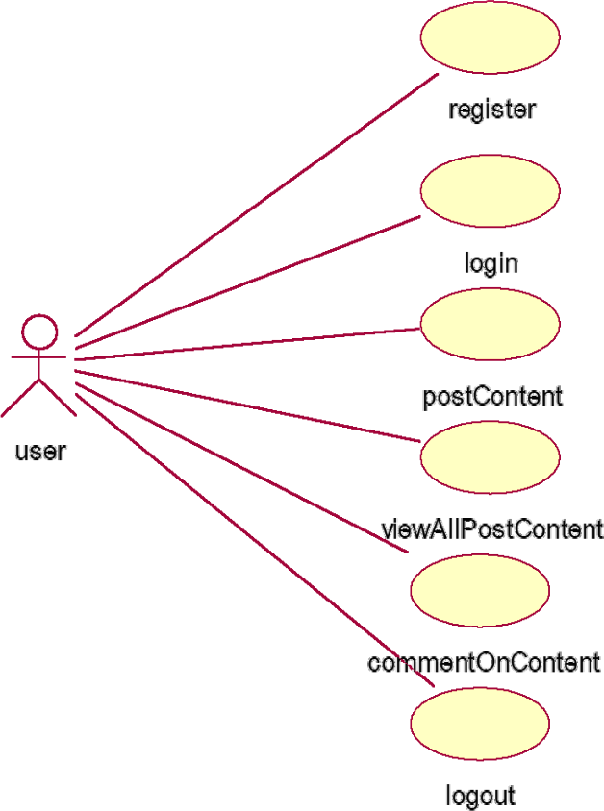
USECASE DIAGRAM
§
§

Slide 17
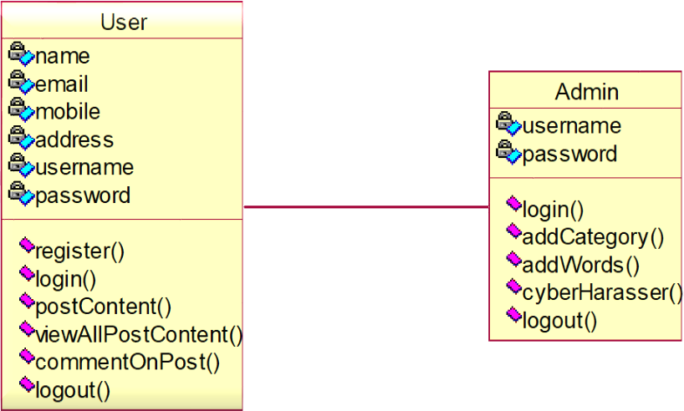
CLASS DIAGRAM
§
§

Slide 18
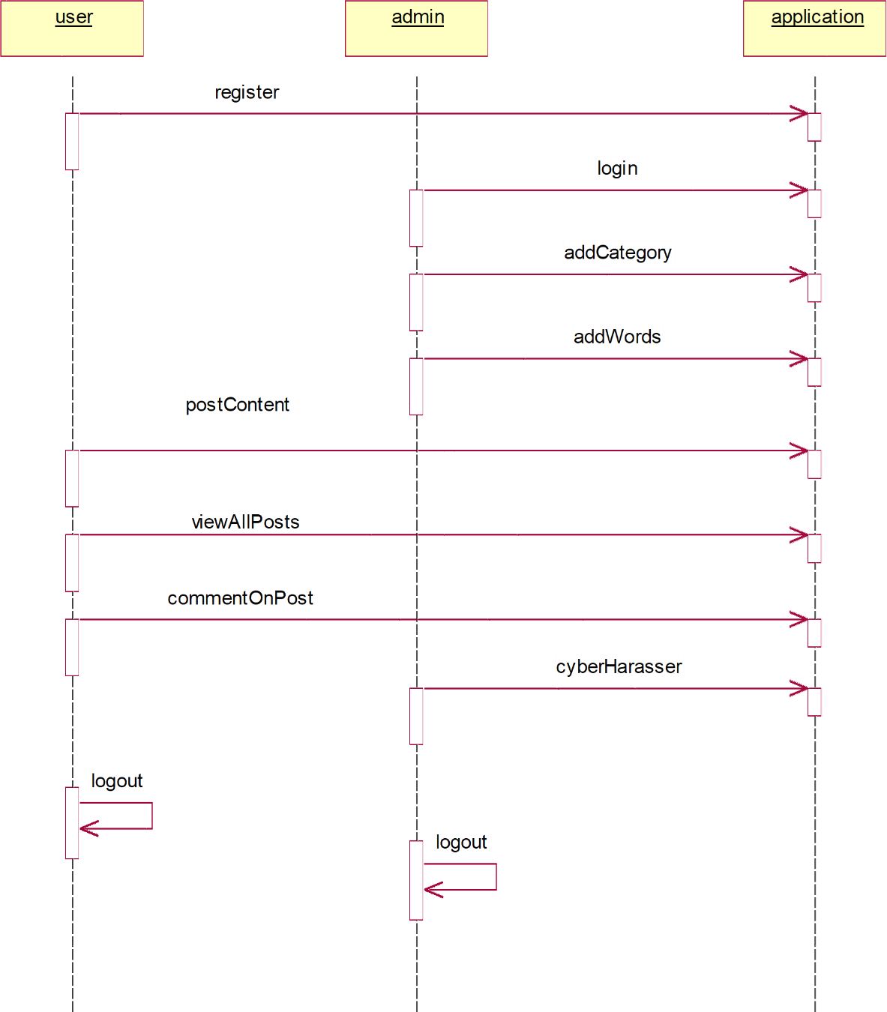
SEQUENCE DIAGRAM
§
§

Slide 19
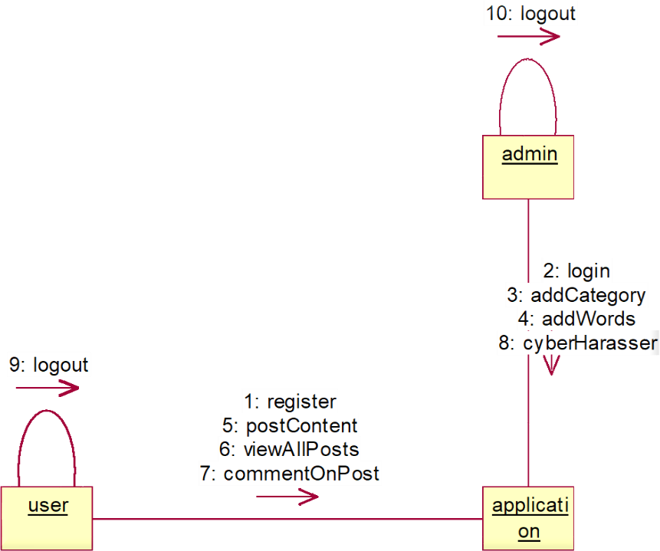
COLLABORATION DIAGRAM
§
§

Slide 20
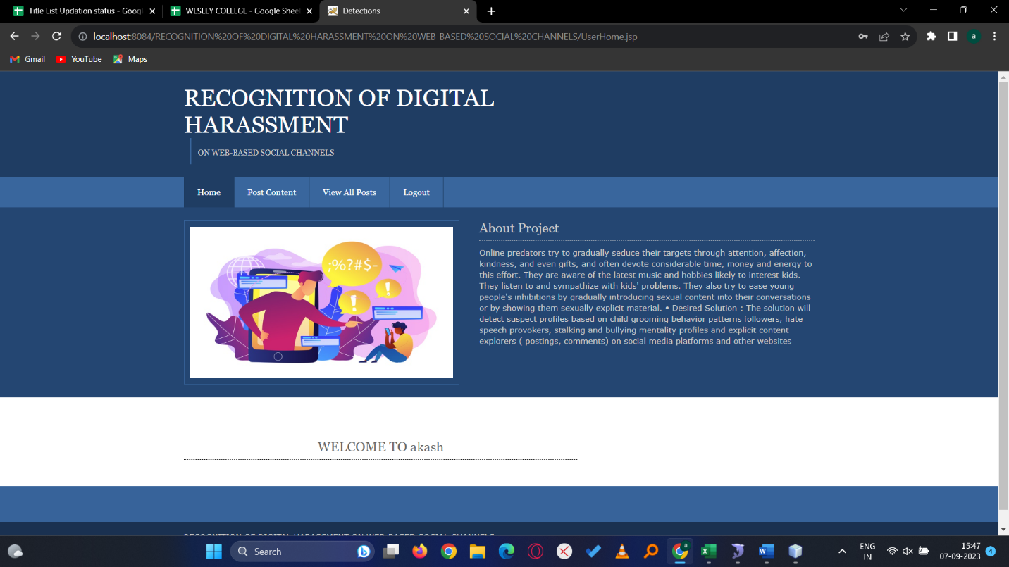
SCREEN SHOTS
HOME SCREENS

Slide 21
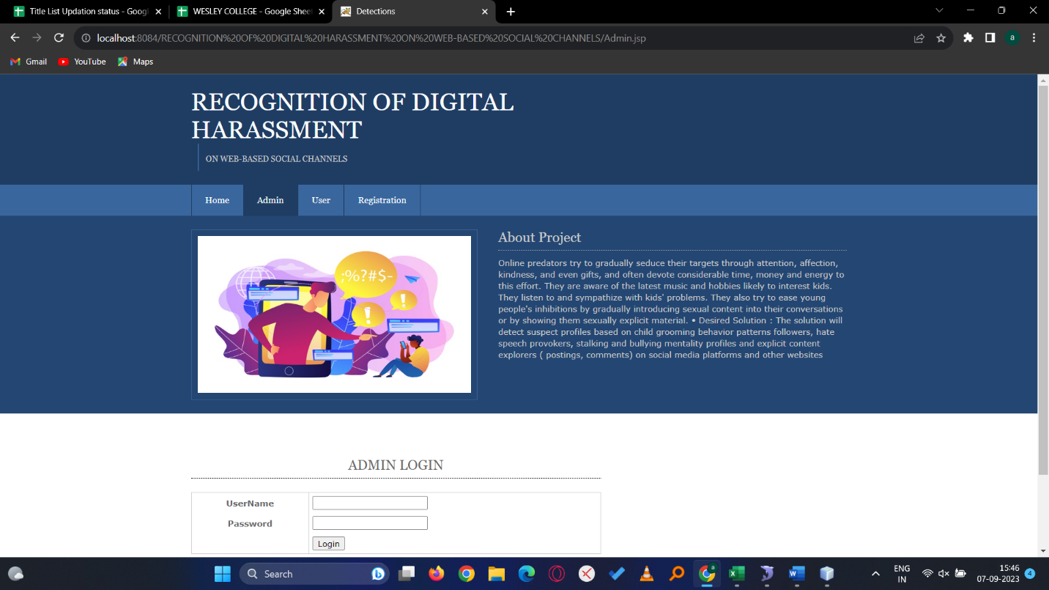
ADMIN LOGIN

Slide 22
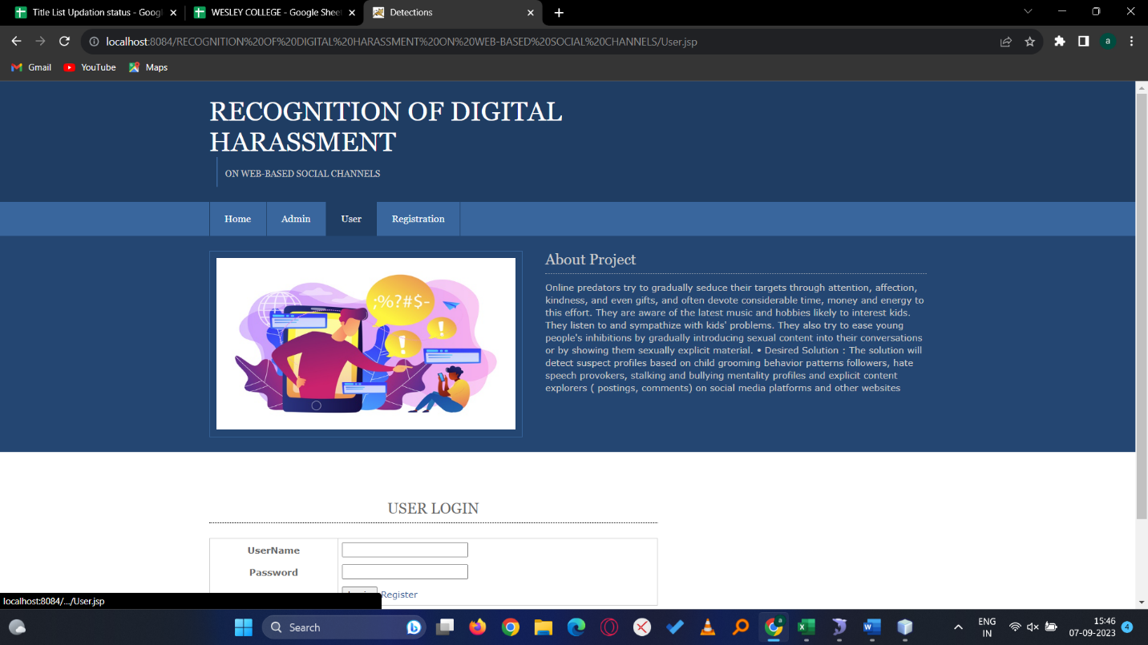
USER

Slide 23
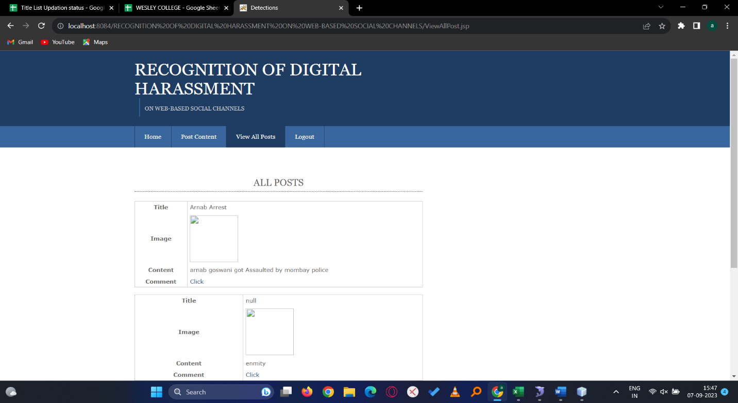
VIEW ALL POSTS

Slide 24
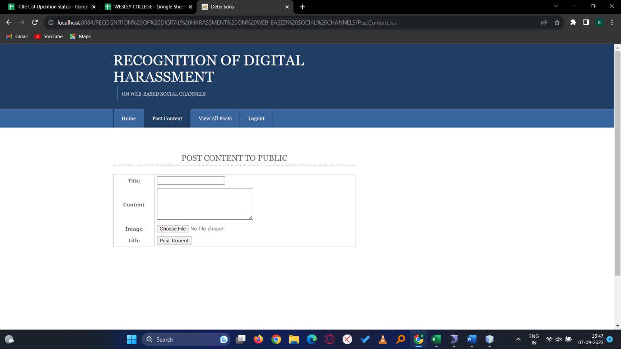
POST CONTENT

Slide 25

ADMIN HOME

Slide 26
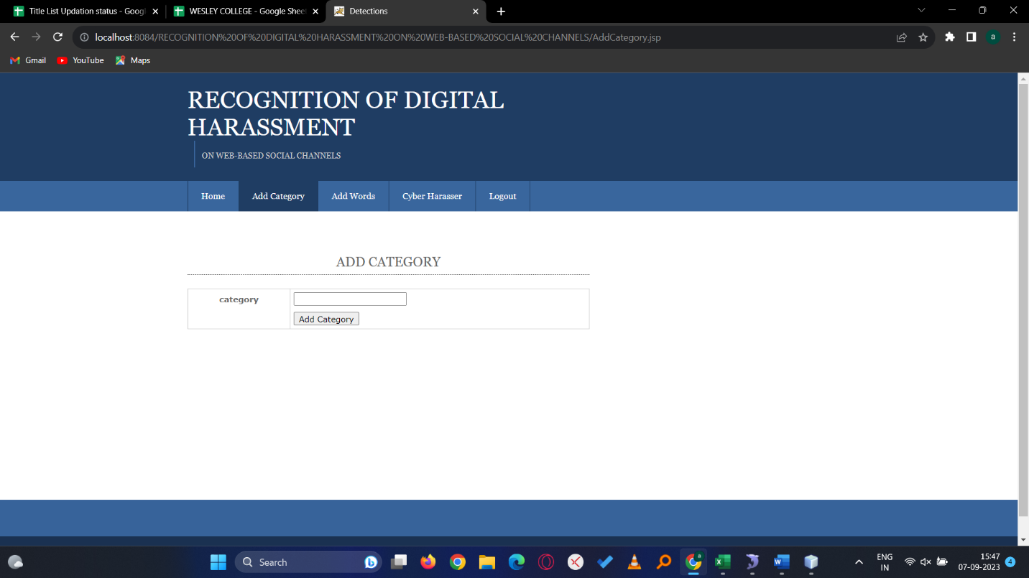
ADD CATEGORY

Slide 27
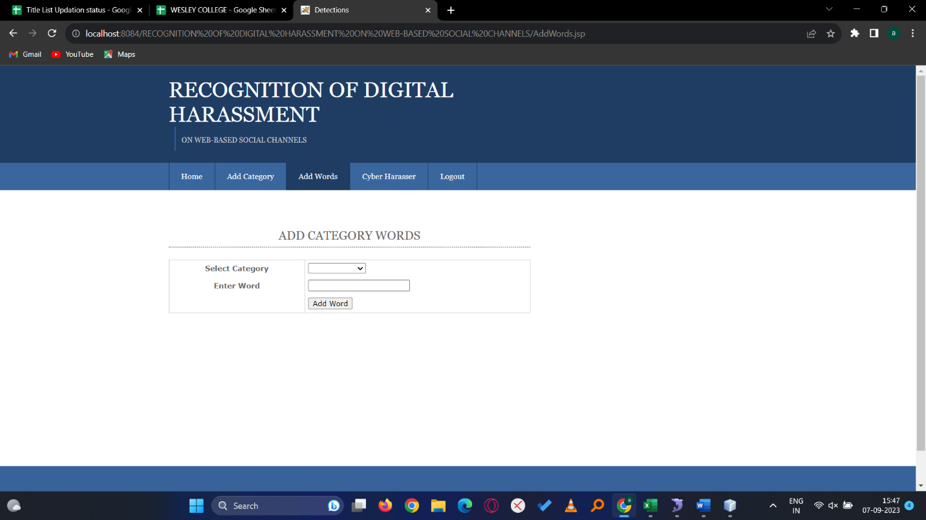
ADD WORDS

Slide 28
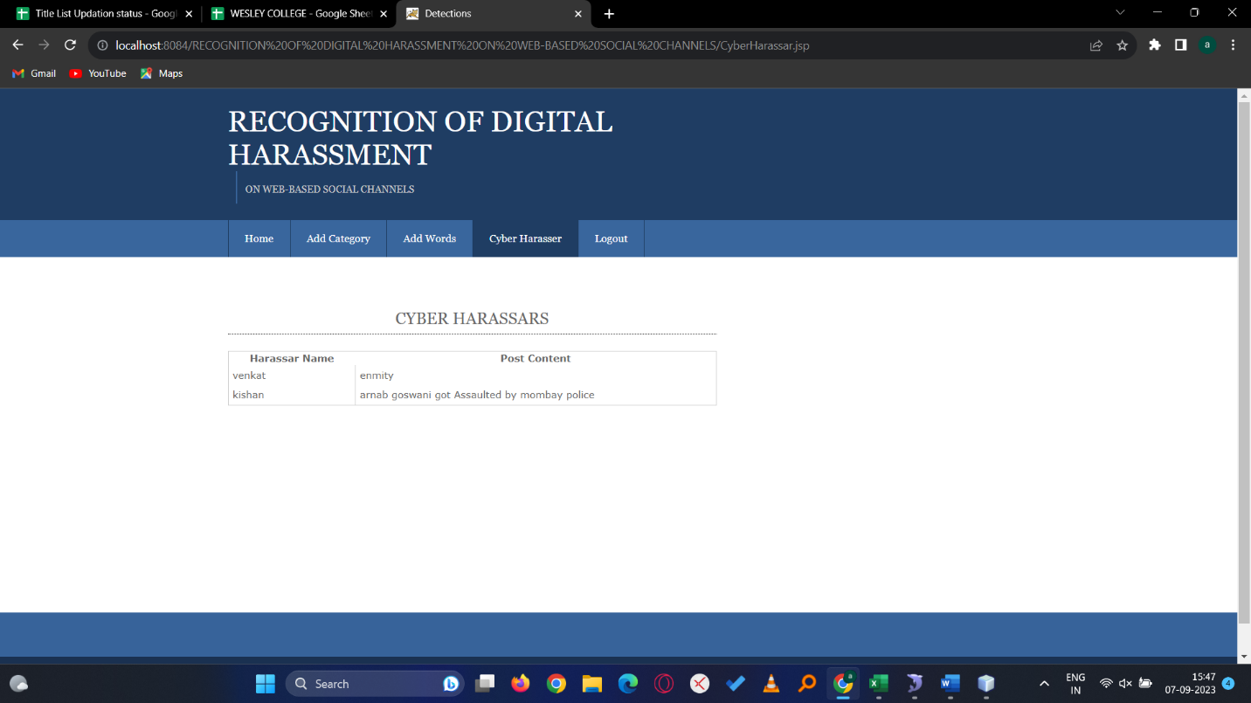
CYBER HARASSERS

Slide 29
CONCLUSION
As each and every one even child is using internet nowadays and getting harassed by predators so in order to stop these predators it is very important to detect and punish them. The main aim of the groomer is to build a relationship with a child in order to gain access to that child. When grooming takes place, it is common that an adult groomer is pretending to be a child with common hobbies or interests to build a relationship with child. In this project we detect child predator for child safety. And send predator report to cyber admin for action.

Slide 30
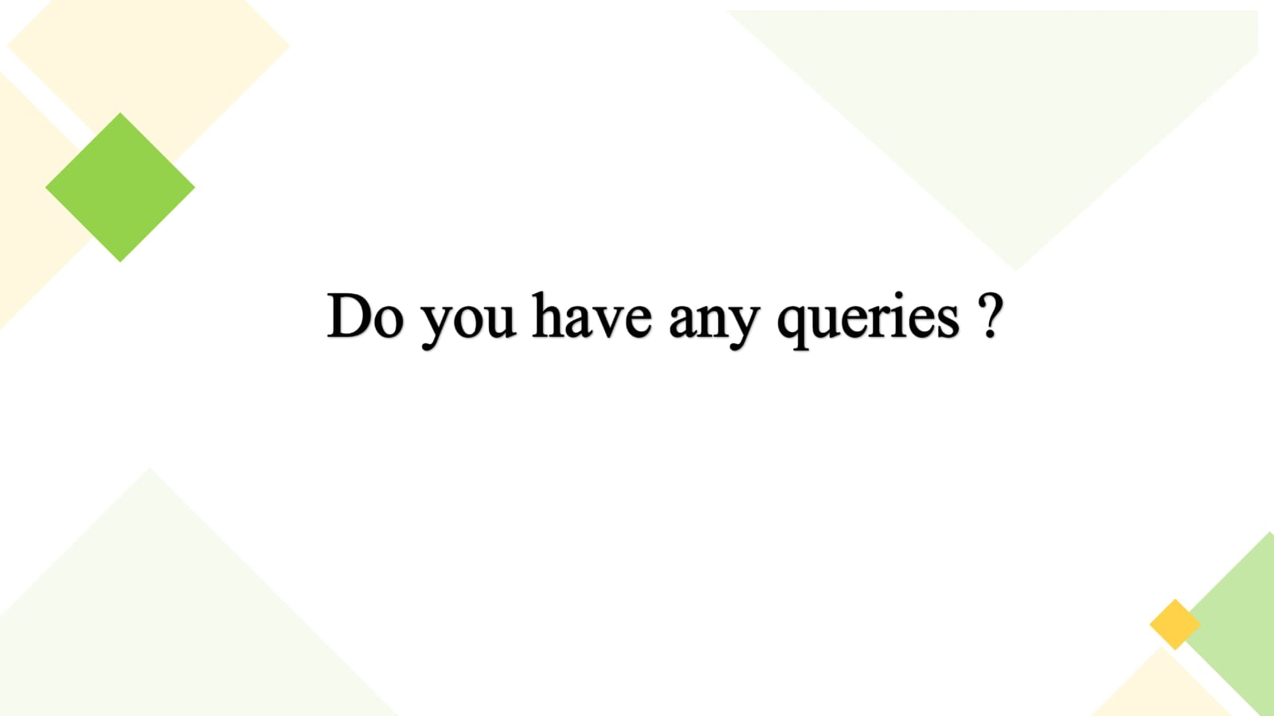


Slide 31


